Slide 1



RMDL: Random Multimodel Deep Learning for Classification
Kamran Kowsari, Mojtaba Heidarysafa, Donald E. Brown,
Kiana Jafari Meimandi, and Laura E. Barnes

Slide 2
Outline
Introduction
Related Works
Feature Extraction
RMDL
Experimental Results
Conclusion
Introduction
Related Works and Baseline
Image Classification
Text Classification
RMDL: Random Multimodel Deep Learning
Deep Neural Networks (DNN)
Recurrent Neural Networks (RNN)
Convolutional Neural Networks (CNN)
RMDL
Results Experimental
Text Results
Image Results
Conclusion

Slide 3
Introduction (Motivation)
Introduction
Related Works
Feature Extraction
RMDL
Experimental Results
Conclusion
The exponential growth in the number datasets requires :
Robust and accurate data classification
Deep learning approaches have achieved surpassing results, but
Finding the suitable structure and architecture for these models has been an important challenge
Which deep learning approach is suitable?
Deep Neural Network (DNN)
Convolutional Neural Network (CNN)
Recurrent Neural Network (RNN)
Convolutional Recurrent Neural Network (CRNN)
etc.
Which deep learning Structure is suitable?
How many hidden layer?
How many nodes?
Which optimizer ?
etc.

Slide 4
Introduction (Motivation)
Introduction
Related Works
Feature Extraction
RMDL
Experimental Results
Conclusion
RMDL (Random Multimodel Deep Learning)
Ensembles of deep learning architectures
Random
Randomly generate number of hidden layer
Randomly choose number node in each hidden layer
Multimodel
Generate n number of models
Deep Learning
Generate r + c + d = n. which
d random model of DNN classifiers,
c models of CNN classifiers,
r RNN classifiers

Slide 5
Introduction (Goal of Project)
Introduction
Related Works
Feature Extraction
RMDL
Experimental Results
Conclusion
RMDL (Random Multimodel Deep Learning)
Which deep learning approach is suitable? (Deep Neural Network (DNN), Convolutional Neural Network CNN), Recurrent Neural Network (RNN))
Which deep learning Structure is suitable? (How many node and hidden layer)
Which optimizer ? (SGD, adam, and etc.)

Slide 6
Related Works (Text)
Introduction
Related Works
Feature Extraction
RMDL
Experimental Results
Conclusion
Recurrent Neural Networks (RNN)
Z. Yang, D. Yang, C. Dyer, X. He, A. J. Smola, and E. H. Hovy, "Hierarchical Attention Networks for Document Classification," in HLT-NAACL, pp. 1480-1489.
Convolutional Neural Networks (CNN)
Y. LeCun, L. Bottou, Y. Bengio, and P. Haffner, "Gradient-based learning applied to document recognition," Proceedings of the IEEE,
Deep Neural Networks (DNN)
Support Vector Machine (SVM)
K. Chen, Z. Zhang, J. Long, and H. Zhang, "Turning from TF-IDF to TF-IGM for term weighting in text classification," (in English), Expert Systems with Applications, vol. 66, pp. 245-260, Dec 30 2016.
Support Vector Machine (SVM)
A. Sun and E.-P. Lim, "Hierarchical text classification and evaluation," in ICDM, pp. 521-528.
Naive Bayes Classification (NBC)
S.-B. Kim, K.-S. Han, H.-C. Rim, and S. H. Myaeng, "Some effective techniques for naive bayes text classification," (in English), IEEE transactions on knowledge and data engineering, vol. 18, no. 11, pp. 1457-1466, Nov 2006.
Hierarchical Deep Learning for Text Classification (HDLTex)
K. Kowsari, D. E. Brown, M. Heidarysafa, K. Jafari Meimandi, M. S. Gerber, and L. E. Barnes, "HDLTex: Hierarchical Deep Learning for Text Classification," in ICMLA, 2017, pp. 364-371.

Slide 7
Related Works (Image)
Introduction
Related Works
Feature Extraction
RMDL
Experimental Results
Conclusion
Deep L2-SVM
Y. Tang, "Deep learning using linear support vector machines," arXiv preprint arXiv:1306.0239, 2013.
Maxout Network
I. J. Goodfellow, D. Warde-Farley, M. Mirza, A. Courville, and Y. Bengio, "Maxout networks," arXiv preprint arXiv:1302.4389, 2013.
BinaryConnect
M. Courbariaux, Y. Bengio, and J.-P. David, "Binaryconnect: Training deep neural networks with binary weights during propagations," in Advances in Neural Information Processing Systems, pp. 3123-3131
PCANet-1
T.-H. Chan, K. Jia, S. Gao, J. Lu, Z. Zeng, and Y. Ma, "PCANet: A simple deep learning baseline for image classification?," IEEE Transactions on Image Processing, vol. 24, no. 12, pp. 5017- 5032, Dec 2015.
gcForest
Z.-H. Zhou and J. Feng, "Deep forest: Towards an alternative to deep neural networks," arXiv preprint arXiv:1702.08835, 2017.

Slide 8
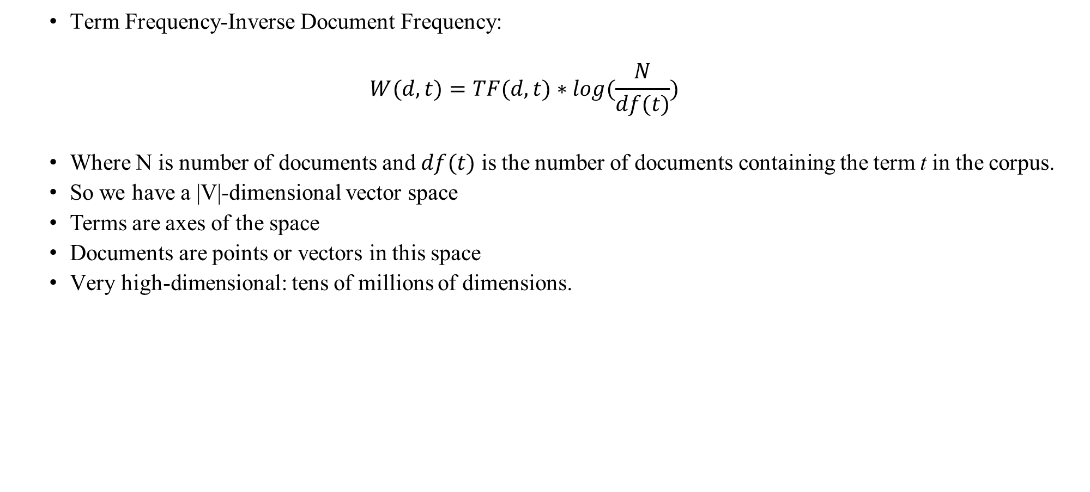
Feature Extraction (tf-idf)
Introduction
Related Works
Feature Extraction
RMDL
Experimental Results
Conclusion
Term Frequency-Inverse Document Frequency:
$$W(d,t)=TF(d,t)∗log(\frac{N}{df(t)})$$
Where N is number of documents and $df(t)$ is the number of documents containing the term t in the corpus.
So we have a |V|-dimensional vector space
Terms are axes of the space
Documents are points or vectors in this space
Very high-dimensional: tens of millions of dimensions.

Slide 9
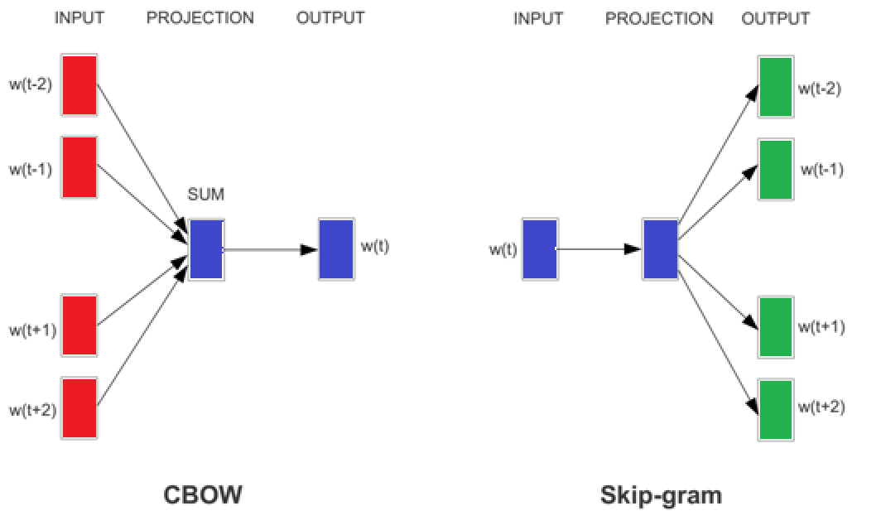
Feature Extraction (Word2Vec)
Introduction
Related Works
Feature Extraction
RMDL
Experimental Results
Conclusion
Vector Representation of Text
Word2Vec:
T. Mikolov et al. presented “word to vector” representation as a better word embedding architecture.
Word2vec approach uses two neural networks namely continuous bag of words (CBOW) and continuous skip-gram to create a high dimension vector for each word.
Represent each word with a low-dimensional vector
Word similarity = vector similarity
basic neural network models:
Continuous Bag of Word (CBOW): use a window of word to predict the middle word
Skip-gram (SG): use a word to predict the surrounding ones in window.

Slide 10
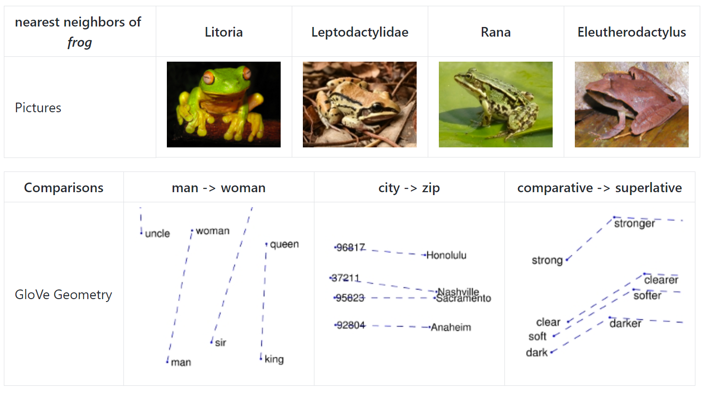
Feature Extraction (GloVe)
Introduction
Related Works
Feature Extraction
RMDL
Experimental Results
Conclusion
Global Vectors for Word Representation (GloVe):
The approach is very similar to “word to vector” method where each word is presented by a high dimension vector and trained based on the surrounding words over a huge corpus.

Slide 11
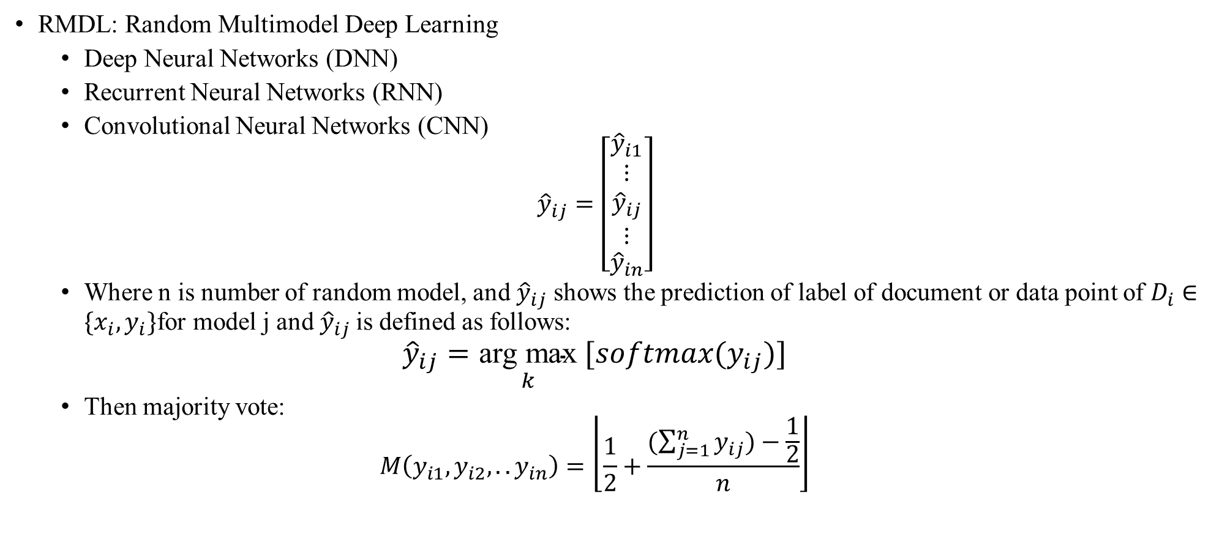
RMDL
Introduction
Related Works
Feature Extraction
RMDL
Experimental Results
Conclusion
RMDL: Random Multimodel Deep Learning
Deep Neural Networks (DNN)
Recurrent Neural Networks (RNN)
Convolutional Neural Networks (CNN)
$${\hat{y}}_{ij}=\left[\begin{matrix}{\hat{y}}_{i1} \\ \begin{matrix}⋮ \\ {\hat{y}}_{ij} \\ ⋮\end{matrix} \\ {\hat{y}}_{in}\end{matrix}\right]$$
Where n is number of random model, and ${\hat{y}}_{ij}$ shows the prediction of label of document or data point of $D_{i}∈\{x_{i},y_{i}\}$for model j and ${\hat{y}}_{ij}$is defined as follows:
$${\hat{y}}_{ij}=\underset{k}{\text{arg} \text{max}} [softmax(y_{ij})]$$
Then majority vote:
$$M\left(y_{i1},y_{i2},..y_{in}\right)=\left\lfloor \frac{1}{2}+\frac{(\sum_{j=1}^{n}{y_{ij})−\frac{1}{2}}}{n}\right\rfloor$$

Slide 12
RMDL (Random Multimodel Deep Learning)
Introduction
Related Works
Feature Extraction
RMDL
Experimental Results
Conclusion

Slide 13
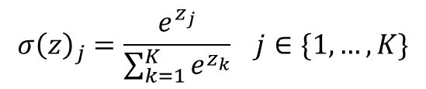
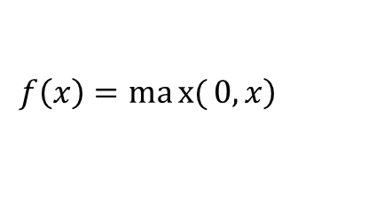
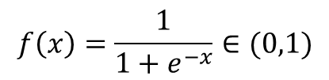
RMDL (DNN)
Introduction
Related Works
Feature Extraction
RMDL
Experimental Results
Conclusion
Deep Neural Networks’ structure is designed to learn by multi connection of layers (each layer only receives connection from previous and provides connections only to the next layer )
The input is a connection of feature space with first hidden layer.
Deep Neural Networks (DNN) is discriminative trained model that uses standard back-propagation algorithm using sigmoid and ReLU:
For multi-class classification, should use Softmax:
$$f\left(x\right)=\frac{1}{1+e^{−x}}∈(0,1)$$
$$\left.f\left(x\right)=max{(}0,x\right)$$
$$σ{\left(z\right)}_{j}=\frac{e^{z_{j}}}{\sum_{k=1}^{K}{e^{z_{k}}}} j∈\{1,…,K\}$$

Slide 14
RMDL (CNN)
Introduction
Related Works
Feature Extraction
RMDL
Experimental Results
Conclusion
CNN have been effectively used for text classification
image processing an image tensor is convolved with a set of kernels of size d×d.
For Image 2D Convolutional Layers and 2D max pool are used.
For Text 1D Convolutional Layers and 1D max pool are used.

Slide 15
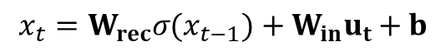
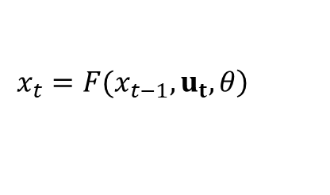
RMDL (RNN)
Introduction
Related Works
Feature Extraction
RMDL
Experimental Results
Conclusion
Another neural network architecture that contributes in RMDL is Recurrent Neural Networks (RNN)
RNN assigns more weights to the previous data points of sequence.
In RNN the neural net considers the information of previous nodes in a very sophisticated method which allows for better semantic analysis of structures of dataset.
General formulation of this concept is given:
weights to formulate with specified parameters:
$$\left.x_{t}=F(x_{t−1},u_{t},θ\right)$$
$$x_{t}=W_{rec}σ(x_{t−1})+W_{in}u_{t}+b$$

Slide 16
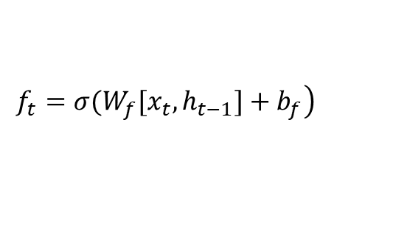
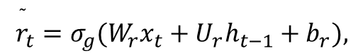
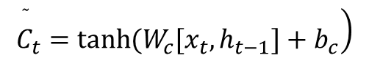
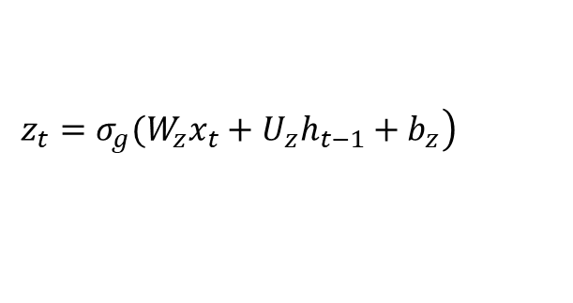
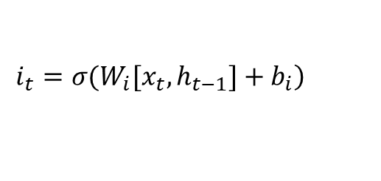
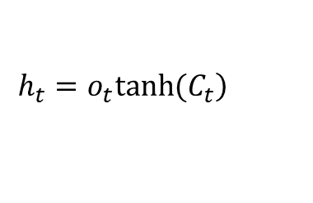
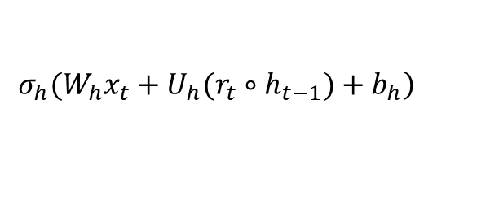
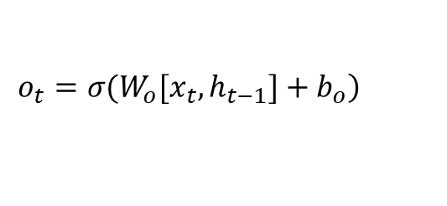
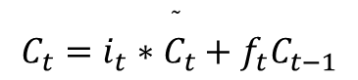
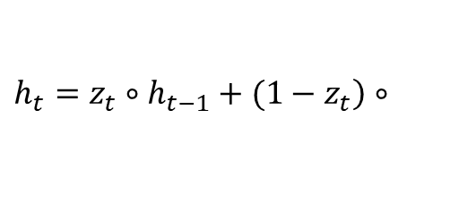
RMDL (RNN)
Introduction
Related Works
Feature Extraction
RMDL
Experimental Results
Conclusion
Long Short-Term Memory (LSTM)
Gated Recurrent Unit (GRU)
$$\left.i_{t}=σ(W_{i}[x_{t},h_{t−1}]+b_{i}\right)$$
$$\left.z_{t}=σ_{g}(W_{z}x_{t}+U_{z}h_{t−1}+b_{z}\right)$$
$$\left.\overset{̃}{C_{t}}=tanh(W_{c}[x_{t},h_{t−1}]+b_{c}\right)$$
$$\overset{̃}{r_{t}}=σ_{g}(W_{r}x_{t}+U_{r}h_{t−1}+b_{r}),$$
$$\left.f_{t}=σ(W_{f}[x_{t},h_{t−1}]+b_{f}\right)$$
$\left.h_{t}=z_{t}∘h_{t−1}+(1−z_{t}\right)$ $∘$
$${C_{t}=i}_{t}∗\overset{̃}{C_{t}}+f_{t}C_{t−1}$$
$$\left.σ_{h}(W_{h}x_{t}+U_{h}(r_{t}∘h_{t−1})+b_{h}\right)$$
$$\left.o_{t}=σ(W_{o}[x_{t},h_{t−1}]+b_{o}\right)$$
$$\left.h_{t}=o_{t}tanh(C_{t}\right)$$

Slide 17
RMDL
Introduction
Related Works
Feature Extraction
RMDL
Experimental Results
Conclusion

Slide 18
RMDL (Optimization)
Introduction
Related Works
Feature Extraction
RMDL
Experimental Results
Conclusion
In RMDL we used different techniques of optimizers:
Stochastic Gradient Descent (SGD)
RMSprop
Adam Optimizer
Adagrad Optimizer

Slide 19
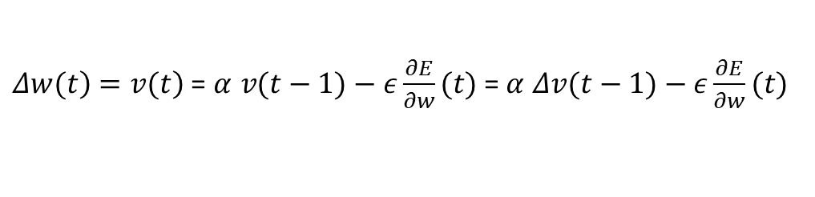
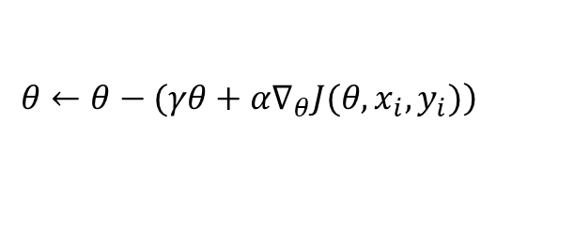
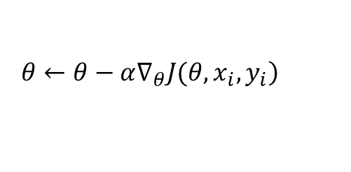
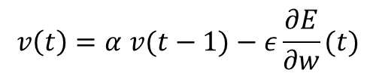
RMDL (Optimization)
Introduction
Related Works
Feature Extraction
RMDL
Experimental Results
Conclusion
In RMDL we used different techniques of optimizers:
Stochastic Gradient Descent (SGD)
The fundamental equation for Stochastic Gradient Descent (SGD) is shown:
for updating parameters
RMSprop
divide the learning rate for a weight by a running average of the magnitudes of recent gradients for that weight.
The equations of the momentum:
RMSProp does not do bias correction which will be a significant problem
$$\left. θ←θ−α∇_{θ}J(θ,x_{i},y_{i}\right)$$
$$\left.θ←θ−(γθ+α∇_{θ}J(θ,x_{i},y_{i})\right)$$
$$v\left(t\right)=α v(t−1)−ε\frac{∂E}{∂w}(t)$$
$\left.Δw(t\right)$ $\left.=v(t\right)$ = $α v(t−1)−ε\frac{∂E}{∂w}(t)$ = $α Δv(t−1)−ε\frac{∂E}{∂w}(t)$

Slide 20
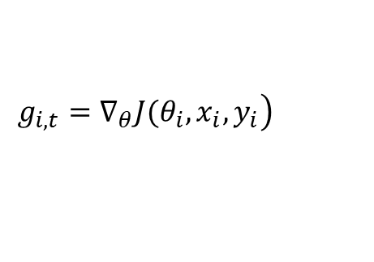
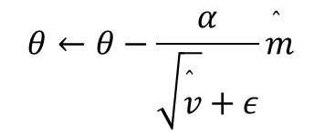
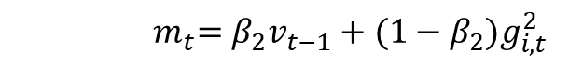
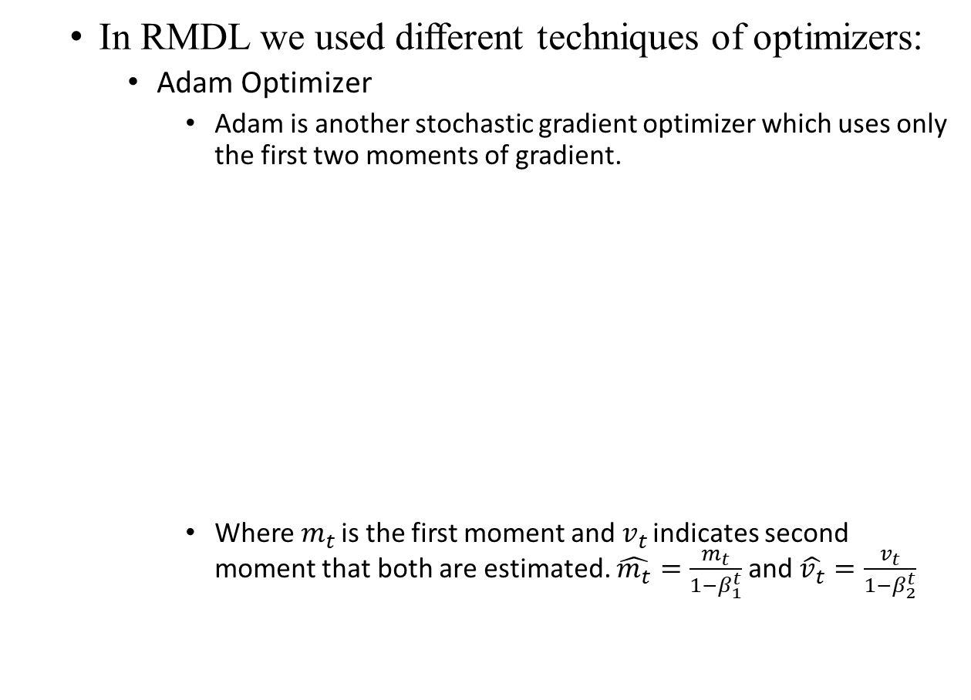
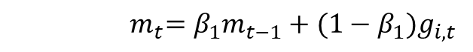
RMDL (Optimization)
Introduction
Related Works
Feature Extraction
RMDL
Experimental Results
Conclusion
In RMDL we used different techniques of optimizers:
Adam Optimizer
Adam is another stochastic gradient optimizer which uses only the first two moments of gradient.
Where $m_{t}$ is the first moment and $v_{t}$ indicates second moment that both are estimated. $\overset{̂}{m_{t}}=\frac{m_{t}}{1−β_{1}^{t}}$ and $\overset{̂}{v_{t}}=\frac{v_{t}}{1−β_{2}^{t}}$
$$θ←θ−\frac{α}{\sqrt{\overset{̂}{v}}+ε}\overset{̂}{m}$$
$$\left.g_{i,t}=∇_{θ}J(θ_{i},x_{i},y_{i}\right)$$
$${ m}_{t}=β_{1}m_{t−1}+(1−β_{1})g_{i,t}$$
$${ m}_{t}=β_{2}v_{t−1}+(1−β_{2})g_{i,t}^{2}$$

Slide 21
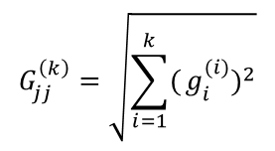
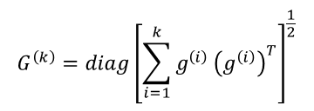
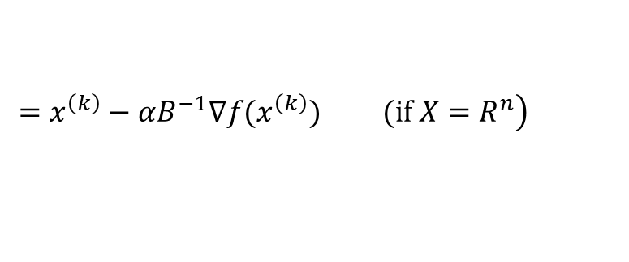
RMDL (Optimization)
Introduction
Related Works
Feature Extraction
RMDL
Experimental Results
Conclusion
In RMDL we used different techniques of optimizers:
Adagrad Optimizer
Adagrad is a novel family of sub-gradient methods which dynamically absorb knowledge of the geometry of the data to perform more informative gradient based learning.
AdaGrad is an extension of SGD. In iteration k, define:
diagonal matrix:
Update
$$G^{\left(k\right)}=diag{\left[\sum_{i=1}^{k}{g^{\left(i\right)}}{\left(g^{\left(i\right)}\right)}^{T}\right]}^{\frac{1}{2}}$$
$$G_{jj}^{\left(k\right)}=\sqrt{\sum_{i=1}^{k}{(}g_{i}^{(i)})^{2}}$$
$x^{\left(k+1\right)}$ = $arg\min_{x∈X}\{⟨∇f(x^{\left(k\right)}),x⟩+\frac{1}{2α_{k}}|\left|x−x^{\left(k\right)}\right||_{G^{\left(k\right)}}^{2}\}$ =
$$\left.=x^{\left(k\right)}−αB^{−1}∇f(x^{\left(k\right)}) (if X=R^{n}\right)$$

Slide 22
Experimental Results (Text)
Introduction
Related Works
Feature Extraction
RMDL
Experimental Results
Conclusion
Dataset:
Reters-21578 Dataset
This dataset contains 21,578 documents with 90 categories.
Web of Science Dataset
Web of Science Dataset WOS-11967
This dataset contains 11,967 documents with 35 categories which include 7 parents categories.
Web of Science Dataset WOS-46985
This dataset contains 46,985 documents with 134 categories which include 7 parents categories.
Web of Science Dataset WOS-5736
This dataset contains 5,736 documents with 11 categories which include 3 parents categories.
20Newsgroups Dataset
This dataset contains 20,000 documents with 20 categories.
IMDB Dataset
This dataset contains 50,000 documents with 2 categories.

Slide 23
Experimental Results (Text)
Introduction
Related Works
Feature Extraction
RMDL
Experimental Results
Conclusion
Methods |  | Dataset
 |  | WOS-5736 | W-11967 | WOS-46985 | Reuters-21578
Baseline | DNN | 86.15 | 80.02 | 66.95 | 85.3
 | CNN | 88.68 | 83.29 | 70.46 | 86.3
 | RNN | 89.46 | 83.96 | 72.12 | 88.4
 | NBC | 78.14 | 68.8 | 46.2 | 83.6
 | SVM | 85.54 | 80.65 | 67.56 | 86.9
 | SVM (TF-IDF) | 88.24 | 83.16 | 70.22 | 88.93
 | Stacking SVM | 85.68 | 79.45 | 71.81 | NA
 | HDLTex | 90.42 | 86.07 | 76.58 | NA
RMDL | 3 RDLs | 90.86 | 87.39 | 78.39 | 89.10
 | 9 RDLs | 92.60 | 90.65 | 81.92 | 90.36
 | 15 RDLs | 92.66 | 91.01 | 81.86 | 89.91
 | 30 RDLs | 93.57 | 91.59 | 82.42 | 90.69

Slide 24
Experimental Results (Text)
Introduction
Related Works
Feature Extraction
RMDL
Experimental Results
Conclusion
Methods |  | Dataset
 |  | IMDB | 20NewsGroup
Baseline | DNN | 88.55 | 86.50
 | CNN | 87.44 | 82.91
 | RNN | 88.59 | 83.75
 | Naive Bayes Classifier | 83.19 | 81.67
 | SVM | 87.97 | 84.57
 | SVM(TF-IDF) | 88.45 | 86.00
RMDL | 3 RDLs | 89.91 | 86.73
 | 9 RDLs | 90.13 | 87.62
 | 15 RDLs | 90.79 | 87.91

Slide 25
Experimental Results (Image)
Introduction
Related Works
Feature Extraction
RMDL
Experimental Results
Conclusion
Dataset:
MNIST Dataset
The MNIST database contains 60,000 training images and 10,000 testing images.
CIFAR-10 Dataset
The CIFAR-10 dataset consists of 60000 32x32 colour images in 10 classes, with 6000 images per class. There are 50000 training images and 10000 test images.
The Database of Faces (The Olivetti Faces Dataset)
he files are in PGM format, and can conveniently be viewed on UNIX (TM) systems using the 'xv' program. The size of each image is 92x112 pixels, with 256 grey levels per pixel. The images are organized in 40 directories (one for each subject), which have names of the form sX, where X indicates the subject number (between 1 and 40). In each of these directories, there are ten different images of that subject, which have names of the form Y.pgm, where Y is the image number for that subject (between 1 and 10).

Slide 26
Experimental Results (Image)
Introduction
Related Works
Feature Extraction
RMDL
Experimental Results
Conclusion
Methods |  | MNIST | CIFAR-10
Baseline | Deep L2-SVM | 0.87 | 11.9
 | Maxout Network | 0.94 | 11.68
 | BinaryConnect | 1.29 | 9.90
 | PCANet-1 | 0.62 | 21.33
 | gcForest | 0.74 | 31.00
RMDL | 3 RDLs | 0.51 | 9.89
 | 9 RDLs | 0.41 | 9.1
 | 15 RDLs | 0.21 | 8.74
 | 30 RDLs | 0.18 | 8.79

Slide 27
Experimental Results (Image)
Introduction
Related Works
Feature Extraction
RMDL
Experimental Results
Conclusion
Methods |  | 5 Images | 7 Images | 9 Images
Baseline | gcForest | 91.00 | 96.67 | 97.50
 | Random Forest | 91.00 | 93.33 | 95.00
 | CNN | 86.50 | 91.67 | 95.00
 | SVM (rbf kernel) | 80.50 | 82.50 | 85.00
 | kNN | 76.00 | 83.33 | 92.50
 | DNN | 85.50 | 90.84 | 92.5
RMDL | 3 RDL | 93.50 | 96.67 | 97.5
 | 9 RDL | 93.50 | 98.34 | 97.5
 | 15 RDL | 94.50 | 96.67 | 97.5
 | 30 RDL | 95.00 | 98.34 | 100.00

Slide 28
Experimental Results (Epochs level)
Introduction
Related Works
Feature Extraction
RMDL
Experimental Results
Conclusion

Slide 29
Conclusion
Introduction
Related Works
Feature Extraction
RMDL
Experimental Results
Conclusion
This paper presents a new technique using stat-of-art machine learning methods, deep learning.
this paper introduces RMDL (Random Multimodel Deep Learning) for the classification that combines multi deep learning models to produce better performance, and solve following problems:
choosing the best structures of Deep Learning
choosing the best architectures of Deep Learning
We’ve Evaluated this approach on datasets such as the Web of Science (WOS), Reuters, MNIST, CIFAR, IMDB, and 20NewsGroups.
Our results show that such multi model deep learning structure can improve classification task on broad range of datasets by using majority vote.

Slide 30
Conclusion
Introduction
Related Works
Feature Extraction
RMDL
Experimental Results
Conclusion
External Link :
Source code is shared at https://github.com/kk7nc/RMDL
Source code passed travis-ci at https://travis-ci.org/kk7nc/RMDL
Run Code:
There are git RMDL in this repository; to clone all the needed files, please use:
The primary requirements for this package are Python 3 with Tensorflow. The requirements.txt file contains a listing of the required Python packages; to install all requirements, run the following:
If the above command does not work, use the following:
Then you can run any of examples:
git clone --recursive https://github.com/kk7nc/RMDL.git
pip -r install requirements.txt
pip3 install -r requirements.txt
cd Examples
python MNIST.py

Slide 31
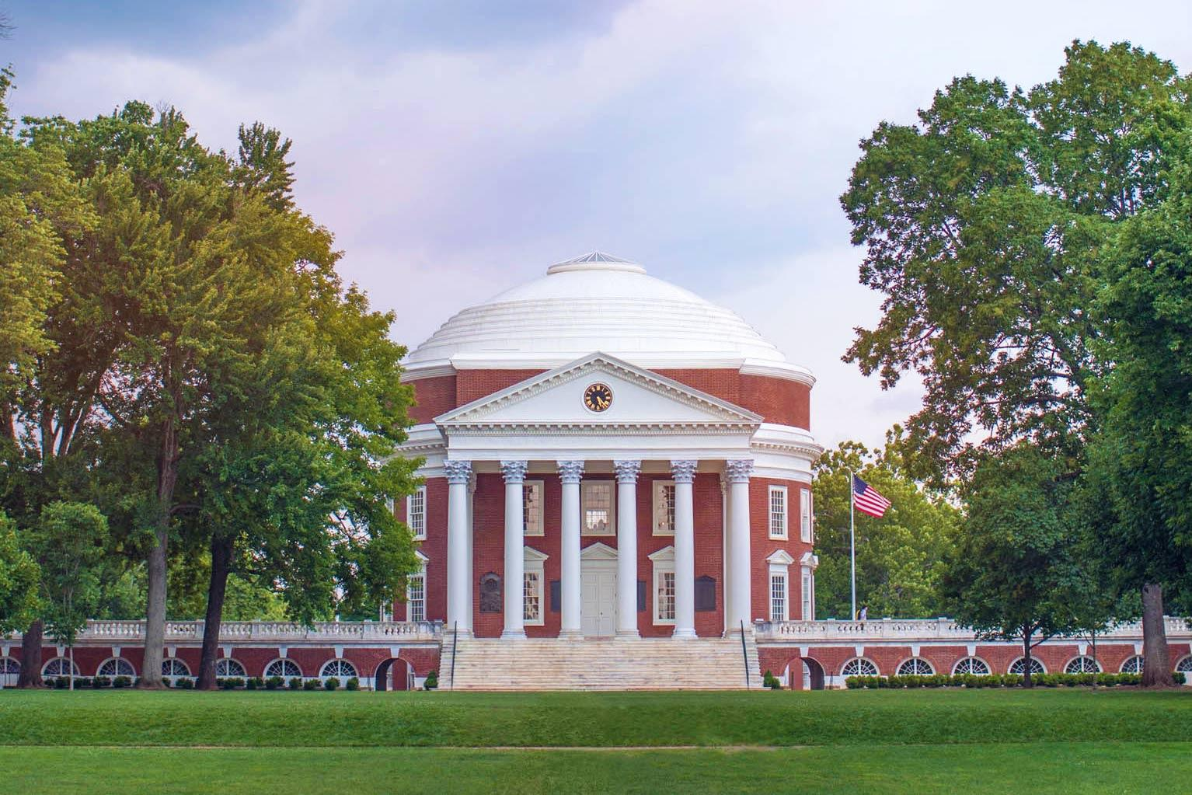

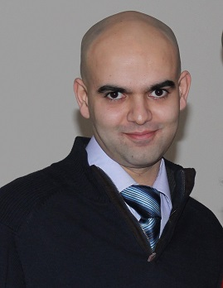
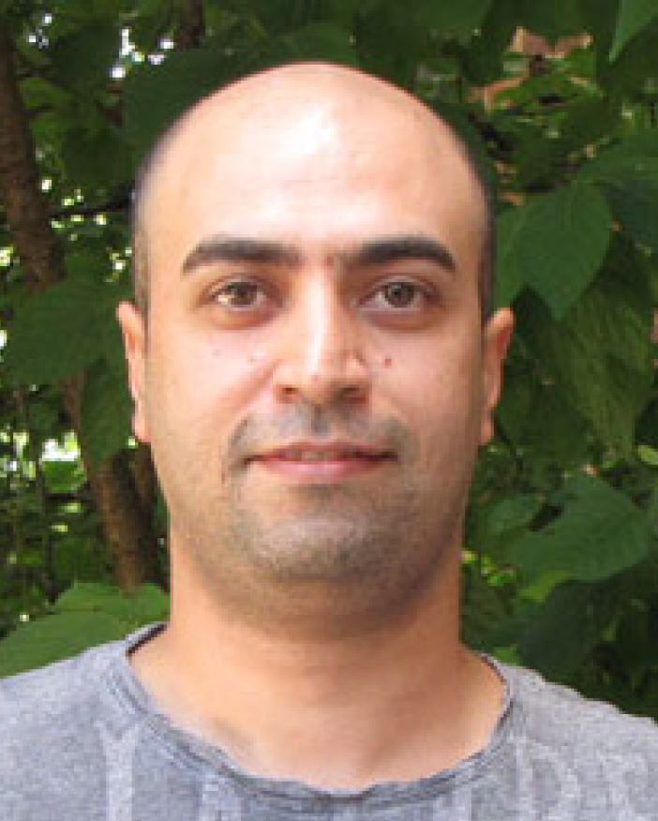

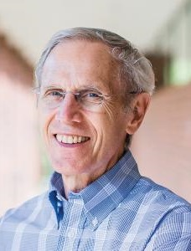
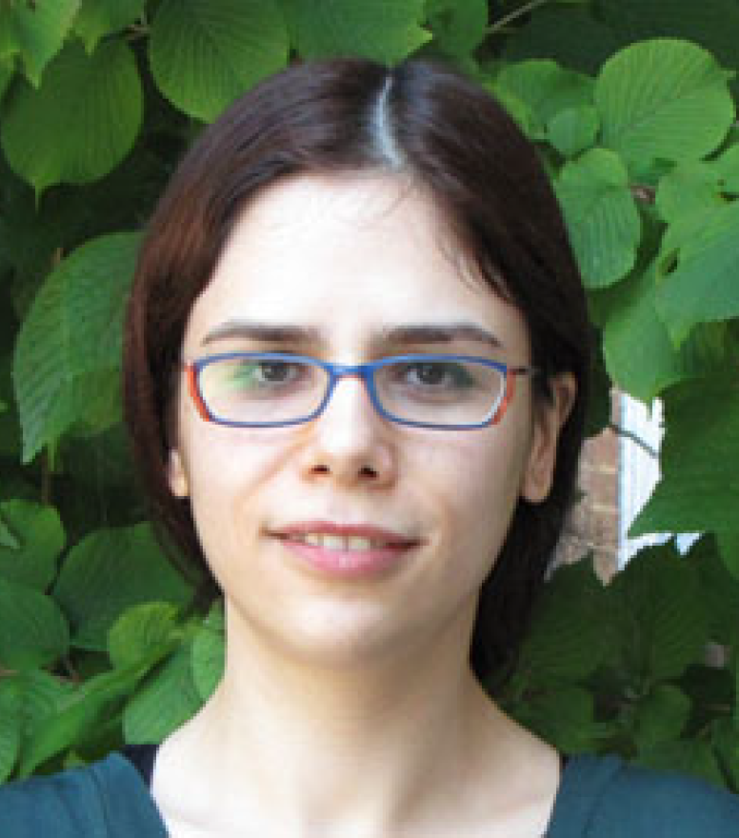
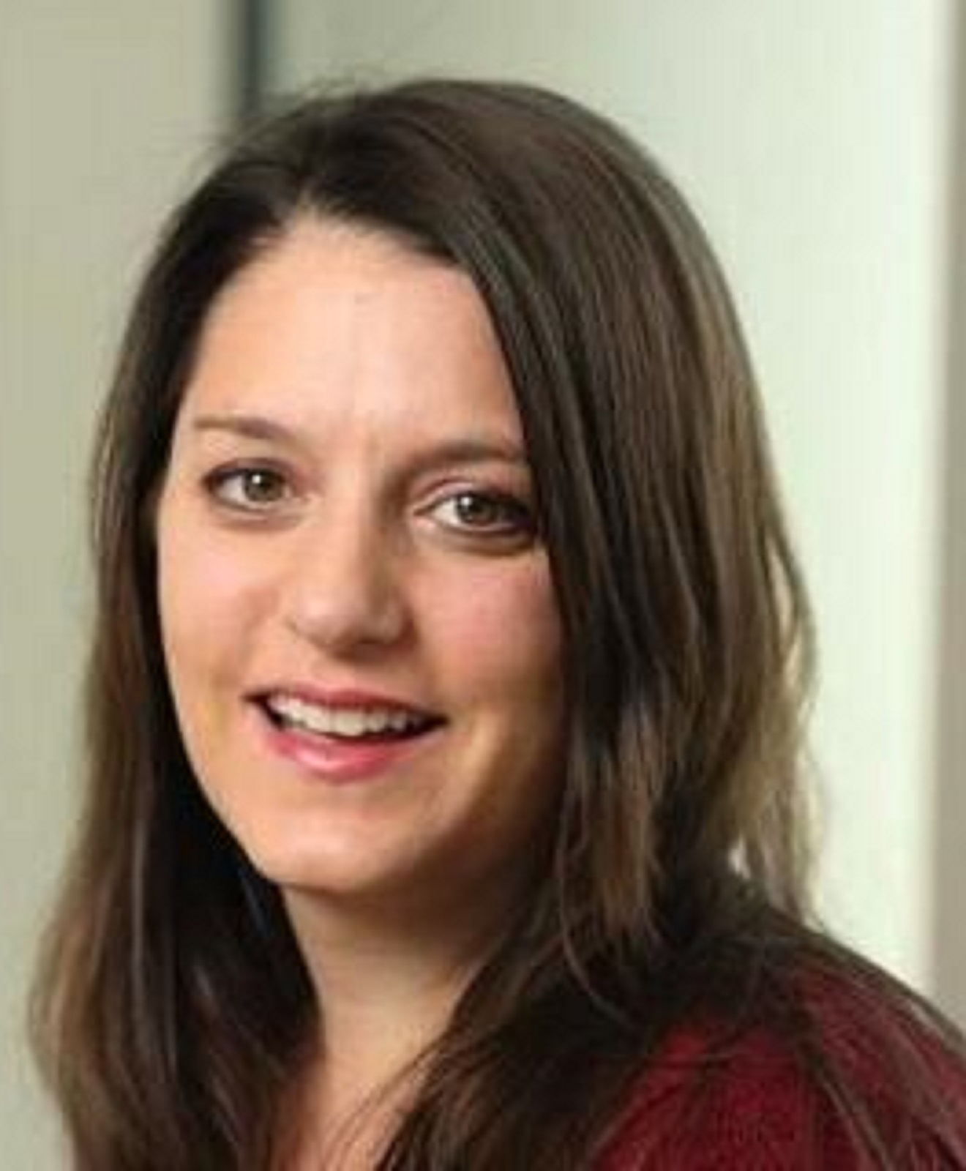
RMDL: Random Multimodel Deep Learning for Classification
Contributor
Kamran Kowsari
(kk7nc@virginia.edu)
Mojtaba Heidarysafa
(mh4pk@virginia.edu)
Donald E. Brown
(deb@virginia.edu)
Kiana Jafari Meimandi
(kj6vd@virginia.edu)
Laura E. Barnes
(lb3dp@virginia.edu)

